Slide 1

epsa*
improve YOUR EFFICIENCY
Global Data Platform
Group IT
January 2025

Slide 2
›
Agenda
Project Identity
Technical Architecture
Future Capabilities
Business Processes & Use Cases
Conclusion & Next Steps
Project Timeline

Slide 3
01
Project Identity
Overview & Mission
›

Slide 4
›
Global Data Platform - Project Identity
CONTEXT
SPONSOR
EPSA Group needs a centralized tool to master and leverage customer data from multiple CRM systems across all entities worldwide.
Yann DANOU
BUILD TEAM
MISSION
5 dedicated people
The GDP is a central Data Hub providing a 360° view of customers. It centralizes and ensures data reliability from various CRMs across the organization.
PRODUCT OWNER
Alexis KOUADIO
+10
360°
Xsell
CRMs Connected
Unified View
Cross-selling

Slide 5
›
The 5 Pillars of the Global Data Platform
Heterogeneous Data Sources
State-of-the-Art Platform
Customer Base
Centralization and reliability of data from Group CRMs and Data Brokers.
Innovative, scalable and robust Data platform ensuring security, auditability and governance.
Enhanced user experience: Xsell, Corporate 360, Targeting, and more use cases.
Reporting & KPIs
Governance
Reports and dashboards to provide key performance indicators for steering.
Committees and financial steering of the program with clear ownership.

Slide 6
02
Technical Architecture
Data Lake & Medallion Architecture
›

Slide 7
›
Architecture Overview
DATA SOURCES
FRONT END
Salesforce
GLOBAL DATA PLATFORM
360° View
Dynamics
→
→
Ingestion
Transformation
Quality
Xsell Module
HubSpot
Medallion Architecture (Bronze → Silver → Gold)
Dashboards
Data Brokers

Slide 8



›
Medallion Architecture
🥉
🥈
🥇
BRONZE
SILVER
GOLD
Raw Data
Cleansed Data
Business-Ready
Data ingested as-is from source systems. No transformation applied.
→
Data cleaned, deduplicated, and validated. Business rules applied.
→
Enriched, aggregated data ready for analytics and business use cases.

Slide 9
03
Business Processes
Use Cases & Value Creation
›

Slide 10
›
Customer Acquisition Funnel
LEAD
PROSPECT
OPPORTUNITY
CUSTOMER
Initial contact
Qualified lead
Business potential
Closed deal
The GDP consolidates data at each stage of the funnel, enabling tracking and optimization of conversion rates across all EPSA entities.

Slide 11
›
360° Customer View
Contacts
Source CRM
Opportunities
360°
ACCOUNT
Interactions
Contracts
Revenue
Unified view of all customer data across multiple CRMs, enabling better decision-making and cross-entity collaboration.

Slide 12
›
Cross-Selling Module (Xsell)
GDP
Entity A
Entity B
→
Xsell Hub
→
Identifies a lead
Receives and
for another BU
Routing & Tracking
converts the lead
+30% Leads
Revenue Growth
Full Traceability
Increased lead generation through cross-entity collaboration
Additional revenue from cross-selling opportunities
Complete tracking from lead creation to conversion

Slide 13
04
Project Timeline
From Launch to Data Driven Enterprise
›

Slide 14
›
Project Timeline - Data Strategy
PLANNED
Advanced Analytics
IN PROGRESS
Self-service BI
Multi-source platform
Finance integration
COMPLETED
Data Brokers integration
Multi-CRM Database
AI and Rules Engine
KPI Dashboards
COMPLETED
Xsell Business Case
20+ new entities
Full Data Driven
Project kickoff & Business Case validation
360 View deployed
2024
2025
2026
2027-28
Foundation
Build
Scale
Data Driven

Slide 15
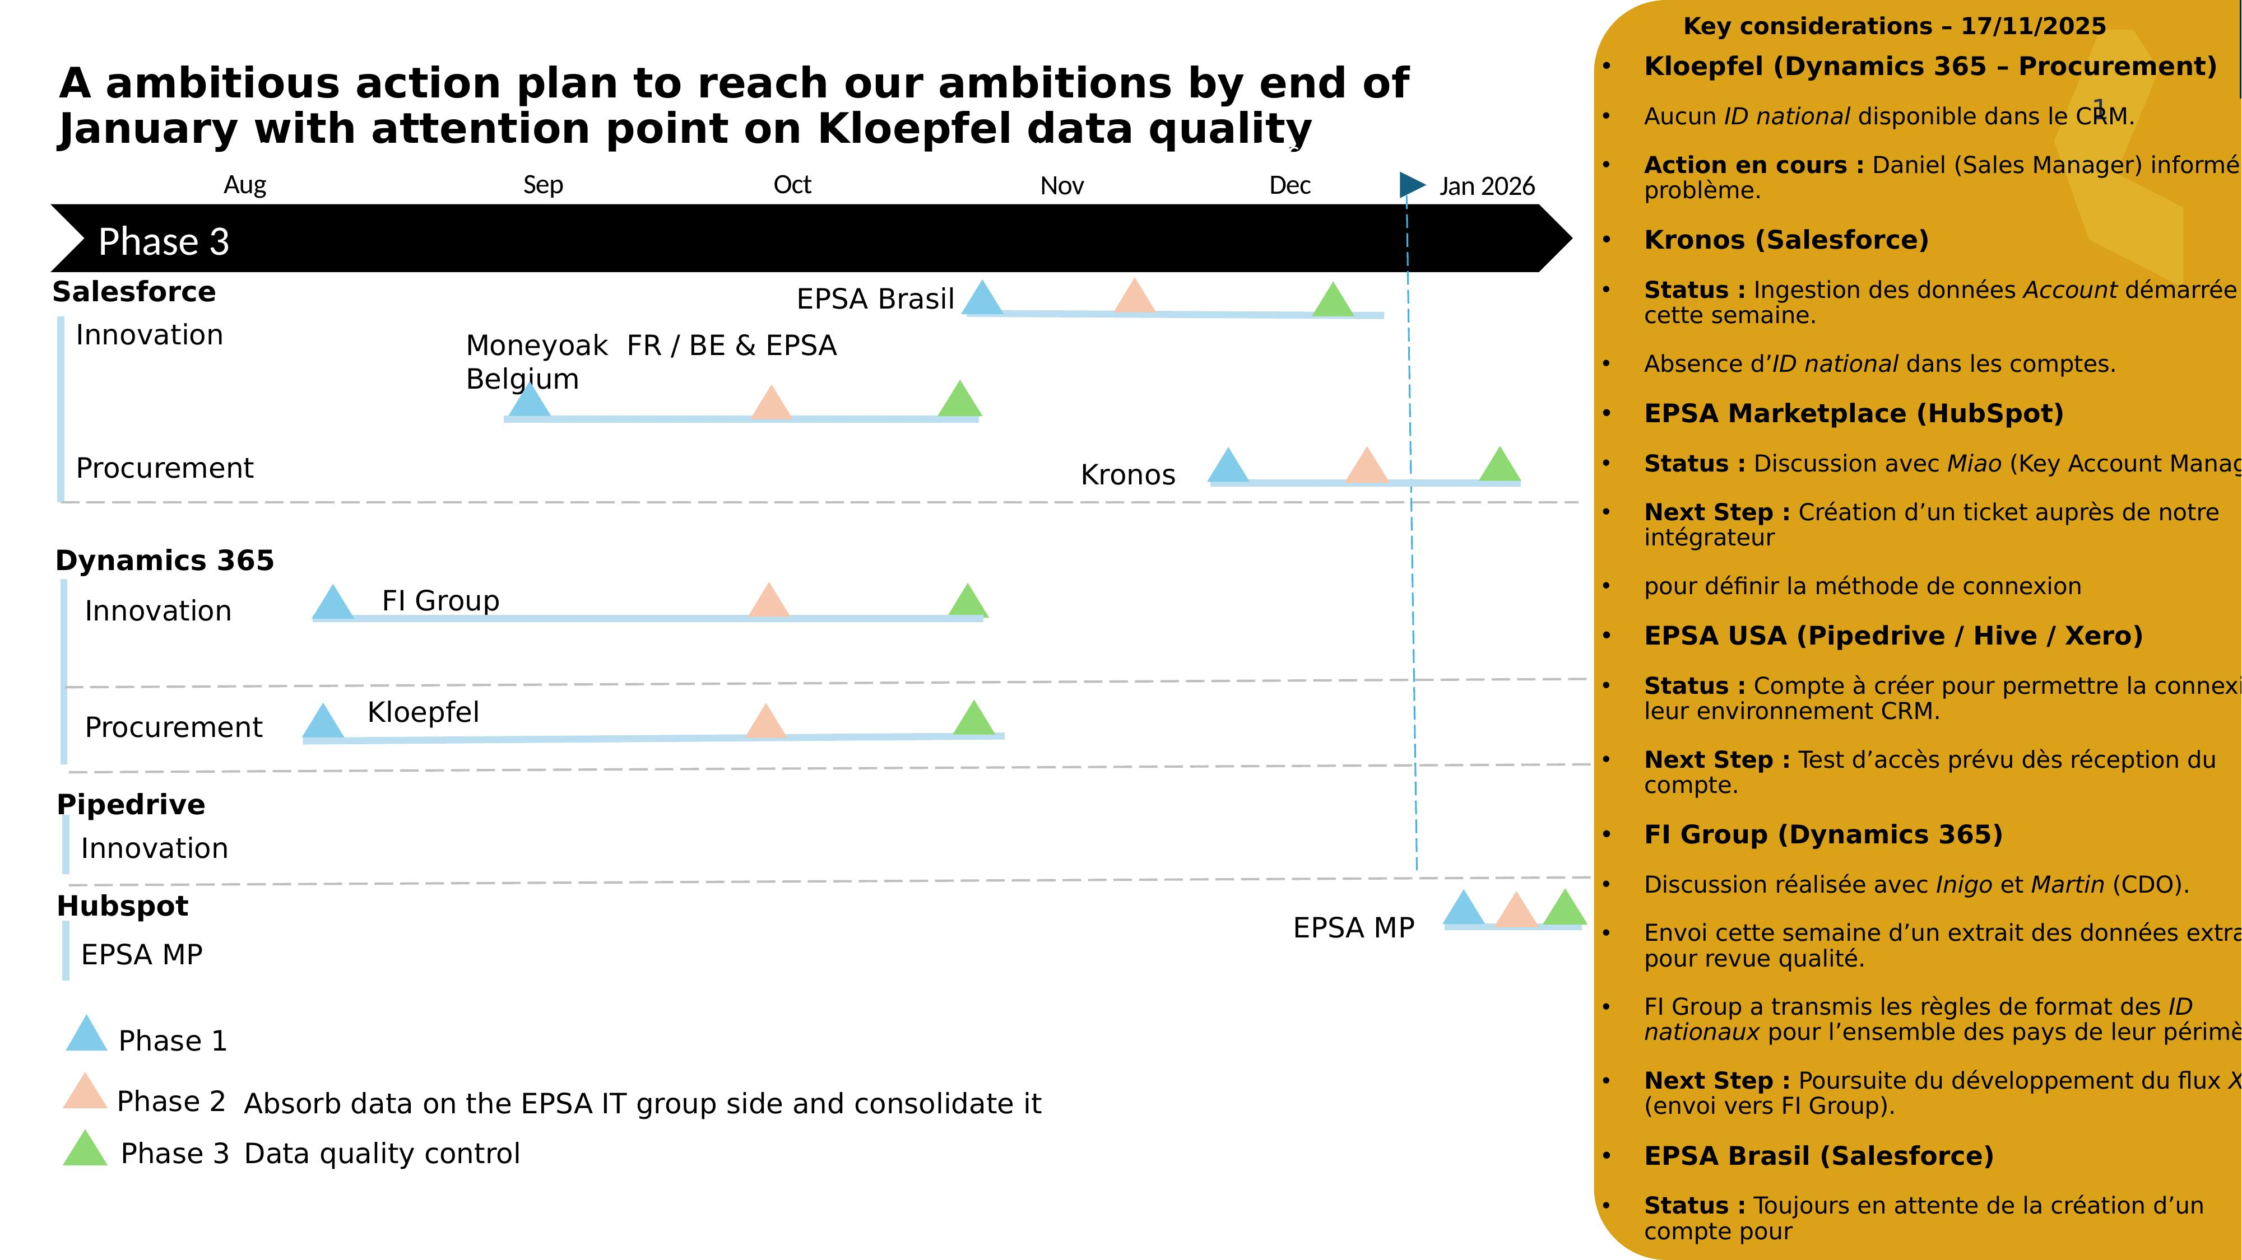

Slide 16
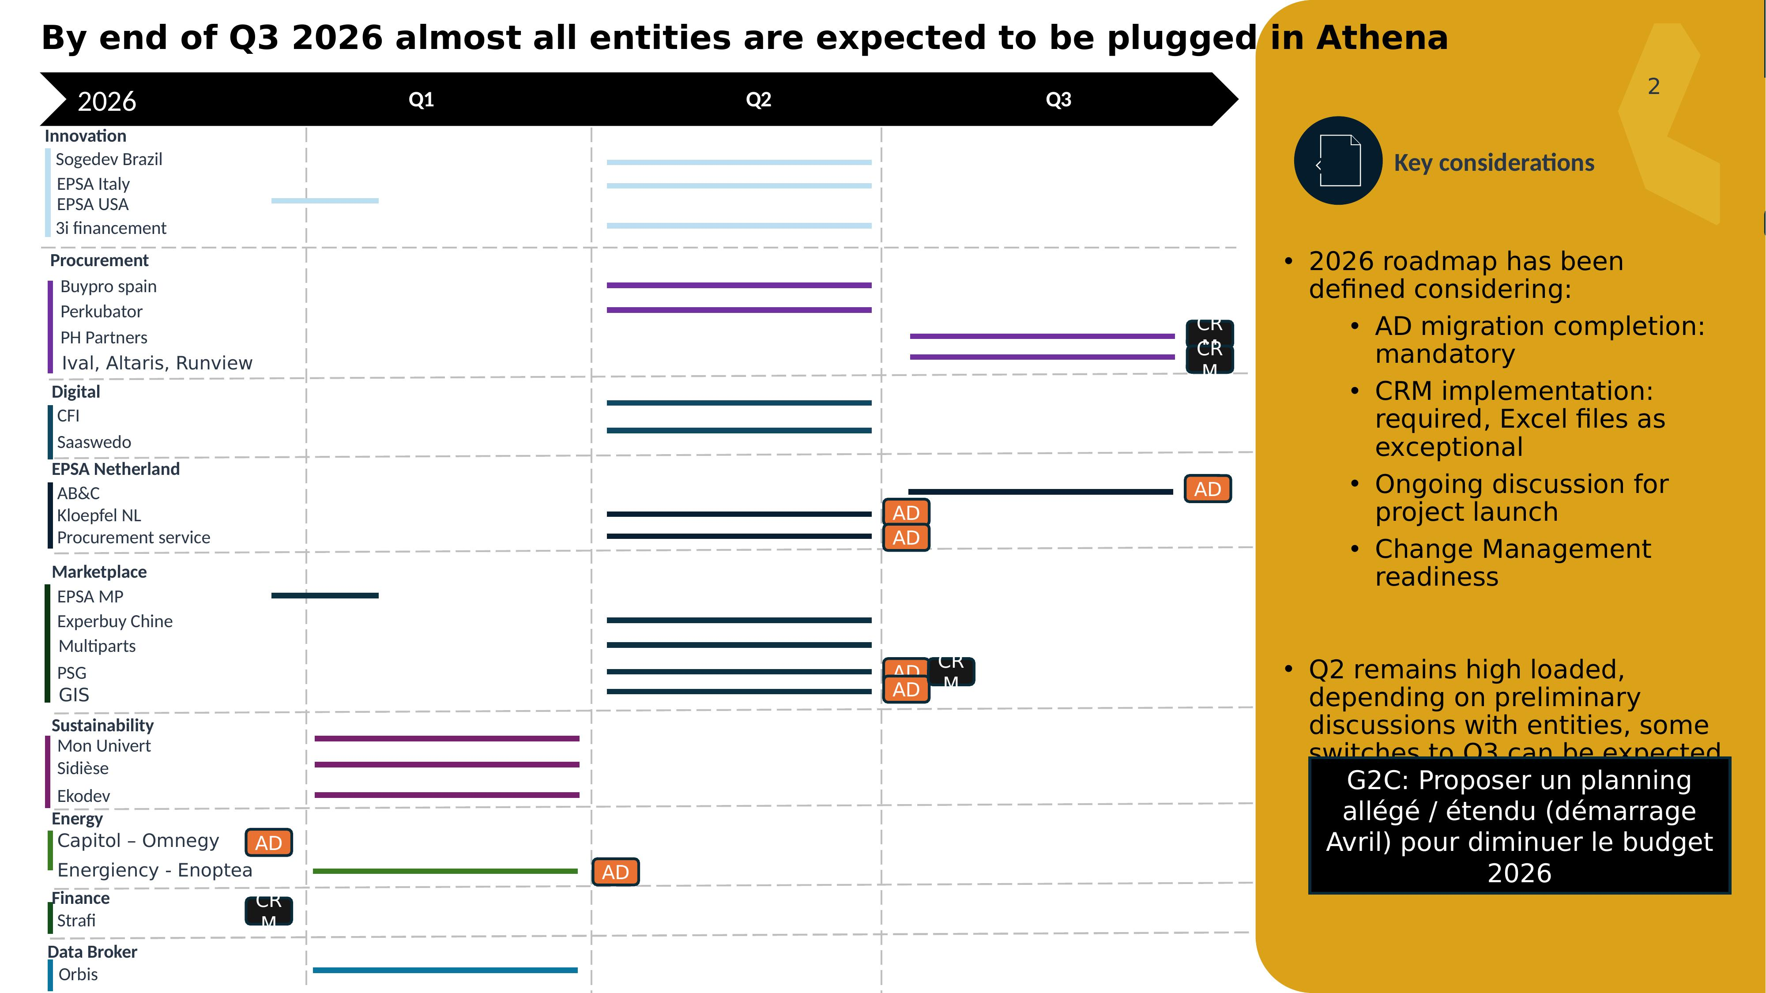

Slide 17
05
Future Capabilities
KPIs, Finance, AI & Rules Engine
›

Slide 18
›
Future Capabilities - Roadmap
KPI Dashboards
AI & Machine Learning
Real-time performance tracking: conversion rates, pipeline velocity, entity benchmarking, and executive reporting.
Predictive scoring, lead prioritization, churn prediction, and intelligent recommendations for sales teams.
Finance Integration
Rules Engine
Connect sales data with financial systems: revenue recognition, forecasting, billing reconciliation, and margin analysis.
Configurable business rules for data quality, routing logic, deduplication criteria, and automated workflows.

Slide 19
CONCLUSION
Next Steps
DONE: COMPLETED
NEXT: COMING 2026
Medallion Data Lake architecture deployed on Azure
Onboarding 20+ new entities (Q1-Q3)
CRM connectors operational (Salesforce, Dynamics, HubSpot)
Data Brokers integration (Orbis, etc.)
Xsell module in production
Advanced Dashboards & Self-service BI
360° View interface deployed
TARGET: Goal 2028: Make EPSA a Data Driven enterprise with a unified global customer view

